Slide 1

Data Science Presentation
[Edu theme]
Team Boston Wolfpack
Ch: Boston Wolfpack
Chaoyi Yuan
Hui Tang
Yizhe Zhang

Slide 2
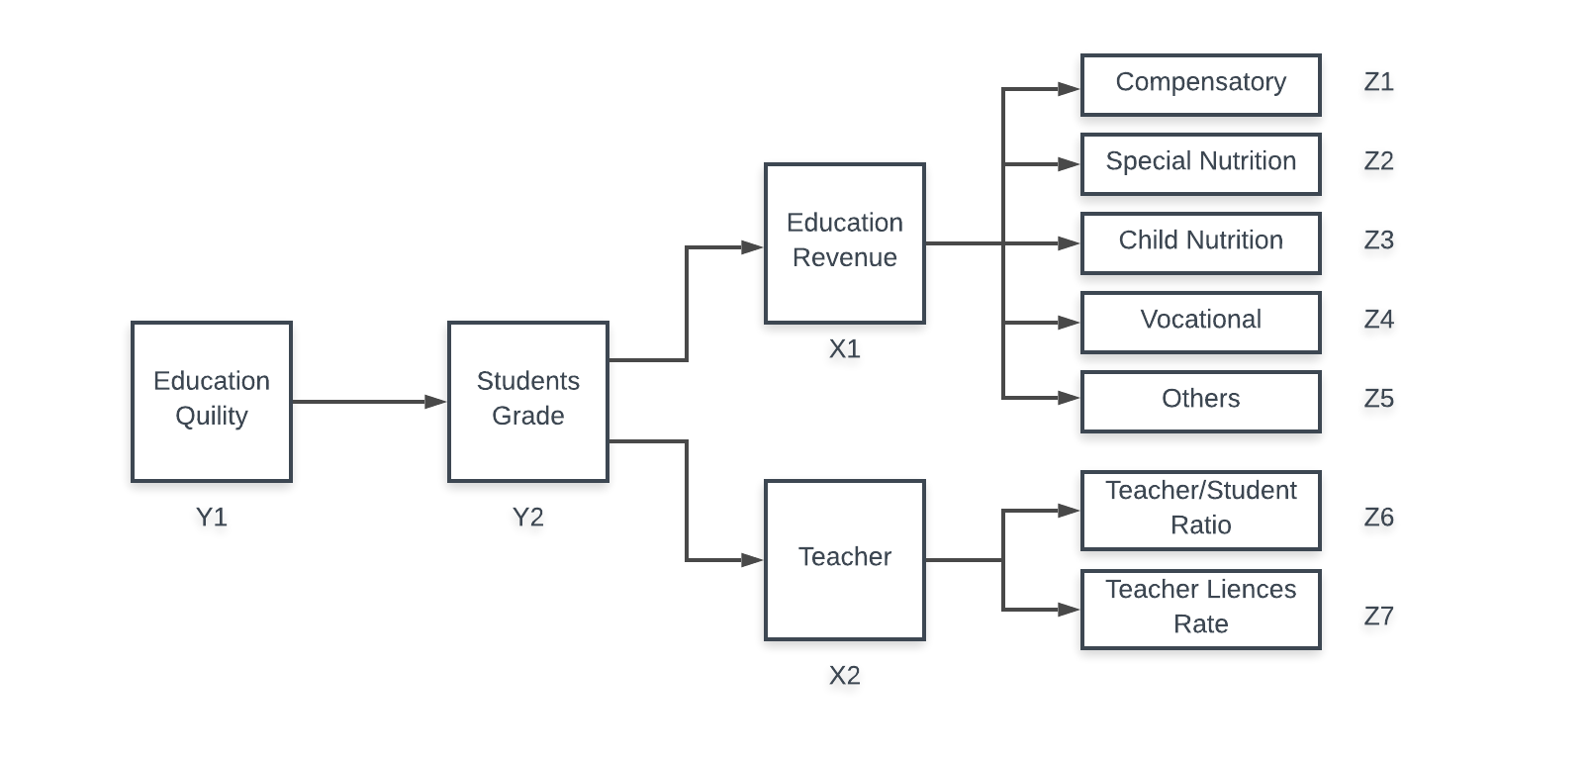
Our Plan
Datasets:
states_all.csv
data.csv
enroll_states.csv
teacherdata.xlsx
gradrates.xlsx
PerpupilExpendit.xlsx
profiles.doe.mass.edu/state_report/
census.gov/programs-surveys/school-finances/data
Regression: Y2 -> X1, X2
Regression: X2 -> Z6, Z7
Cluster: X1 -> Z1, Z2, Z3, Z4, Z5

Slide 3
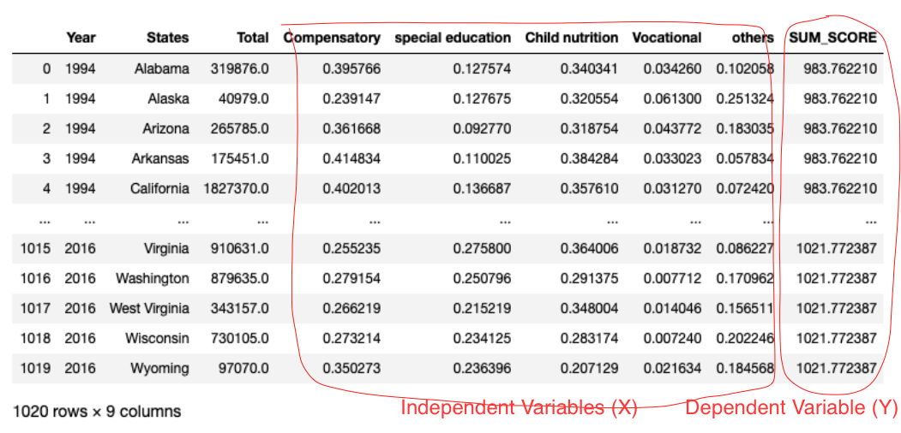
Data Cleansing

Slide 4
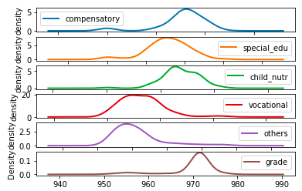
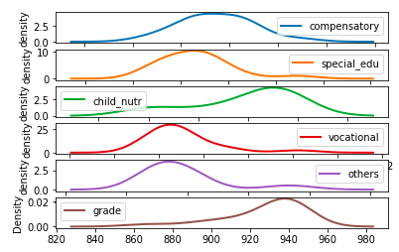
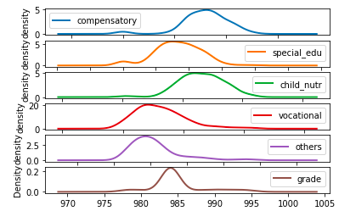
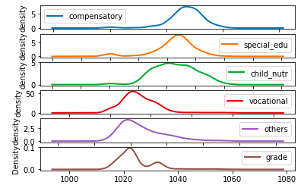
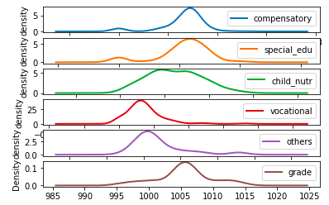
Relationship between Students Grade and Different Investment Ratio
Group Index | Compensatory | Special Education | Child Nutrition | Vocational | Others | Grade | Count
0 | 0.317935 | 0.166543 | 0.262836 | 0.031112 | 0.221574 | 984.873561 | 239
1 | 0.268594 | 0.226138 | 0.229287 | 0.014165 | 0.261794 | 1024.26556 | 378
2 | 0.262966 | 0.215131 | 0.223313 | 0.018397 | 0.280193 | 1005.51694 | 232
3 | 0.372404 | 0.116946 | 0.292407 | 0.030563 | 0.187680 | 927.158777 | 18
4 | 0.310572 | 0.157155 | 0.274925 | 0.032473 | 0.224877 | 969.784123 | 153
Group 4
Group 3
Group 0
Group 2
Group 1

Slide 5
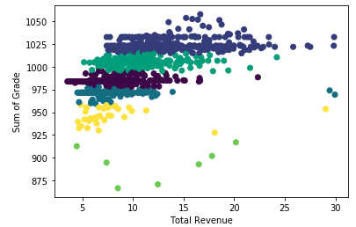
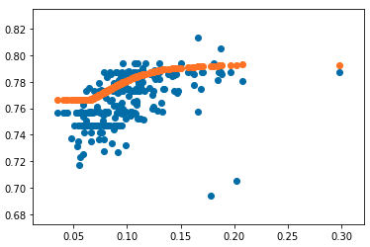
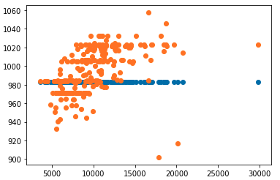
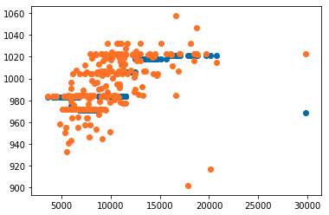
Analysis between education revenue per student and students grade
Cluster Model
Neurons Network
Multinomial Naive Bayes Classifier
Gaussian naive bayes
Logistic Regression
SVM

Slide 6
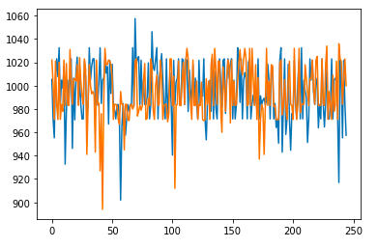
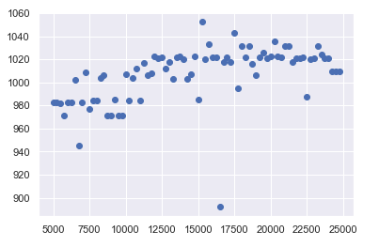
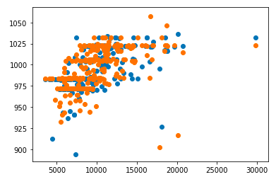
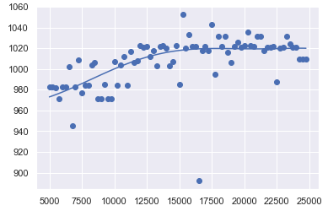
Decision Tree and Random Forest
Result
Prediction y V.S. Observation y
Prediction V.S. Observation Points
Polynomial Regression (Degree 6)

Slide 7
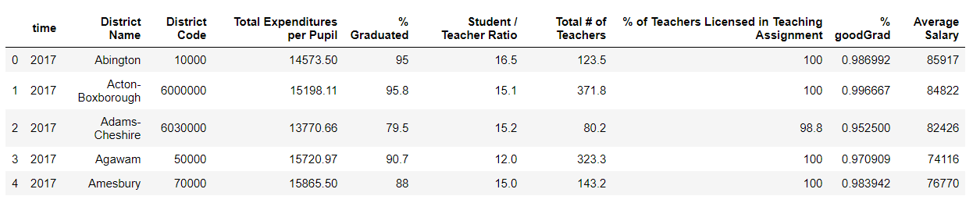
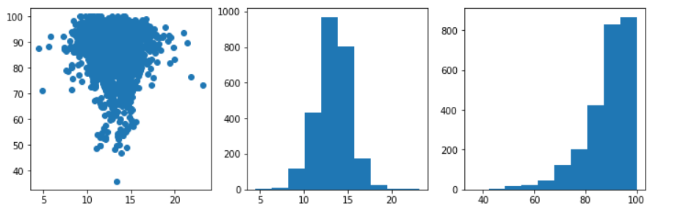
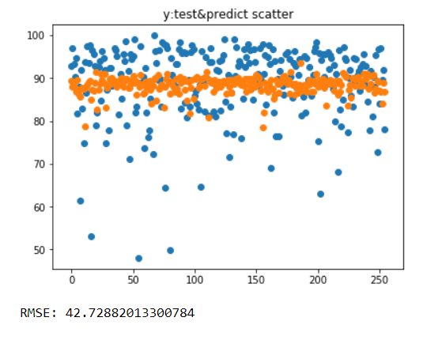
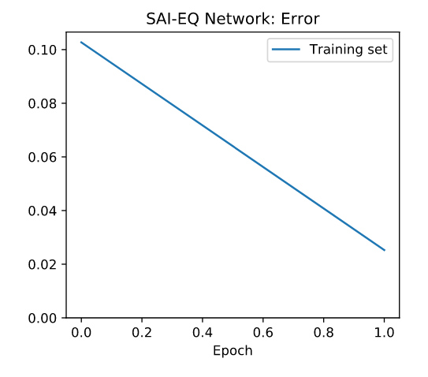

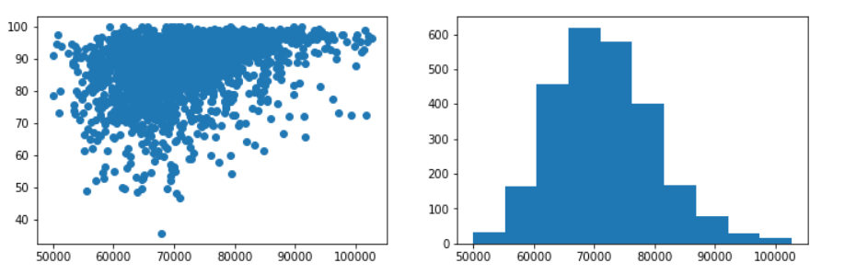
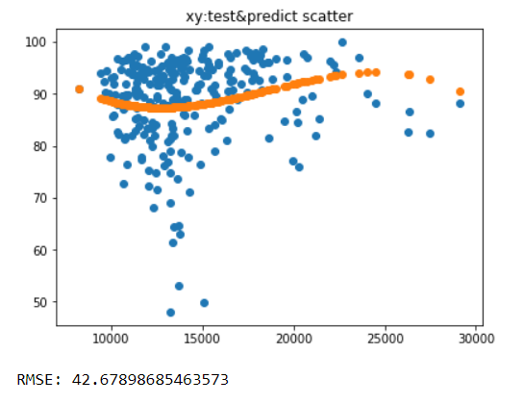
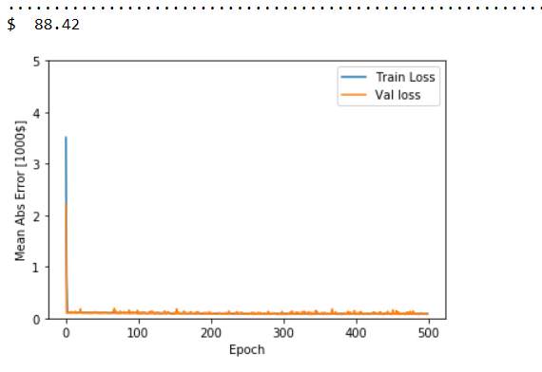

MA Data Cleaning & Handling
different independent variables(X)
dependent variable(Y)
Cleaning Result:
2541 rows,10 columns
Correlation Test Result:
These Xs correlate with Y
Data Visualization
* Data sets from: doe.mass.edu (From 2006 to 2017)

Slide 8
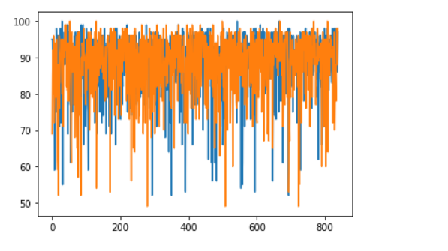
Relationship between
Graduated Rate with Student/Teacher Ratio & Licensed Teachers Ratio
Random Forest
X1:
Licensed Teachers Rate:
[84, 86, 88, 90, 92, 94, 96, 98, 100]
S/T Ratio:
[4, 6, 8, 10, 12, 14, 16, 18, 20, 22]
↓
Combined Data: (‘S/T ratio’, ‘Licensed Teachers Rate’)
(4, 84), (4, 86),...,(4, 92),..., (4, 98), (4, 100)
…...
(22, 84), (22, 86),..., (22, 92),..., (22, 98), (22, 100)
X2:
Y:Graduated Rate-Predicted (Blue)
Y:Graduated Rate-Test (Orange)
# same Student / Teacher Ratio ->change licensed teacher Ratio
>> no Conclusion…
# same licensed teacher Ratio ->change Student / Teacher Ratio
>> it works

Slide 9
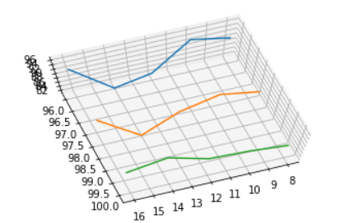
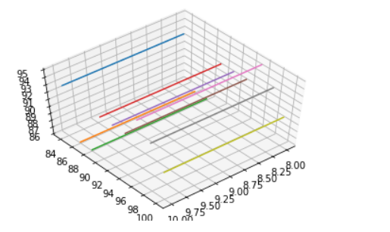
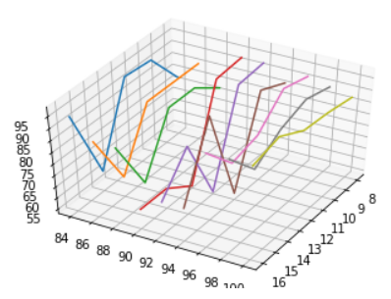
Relationship between
Graduated Rate with Student/Teacher Ratio & Licensed Teachers Ratio
Same Licensed Teacher Ratio ->Changed Student / Teacher Ratio
here
z
z
z
y
x
y
y
x
x
X: S/T Ratio
Y: Licensed Teacher Ratio
Z: Graduated Rate
Y: Licensed teachers>96%
Graduation rate keep high with relative small fluctuation
X: S/T rate<10
Graduation rate keep high(>86%)
Let’s do Segmented analysis-->
* We assume Good Graduated Rate>80%

Slide 10
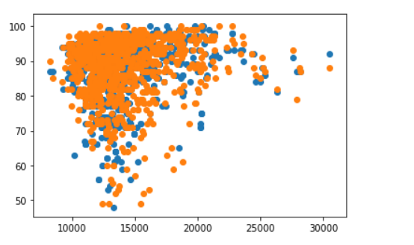
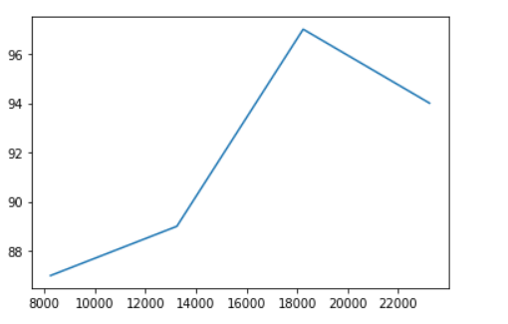
Relationship between student achievement index and ExpenditurePerPupil
Random forest(Graduated rate -- Total Expenditures per Pupil)

Slide 11
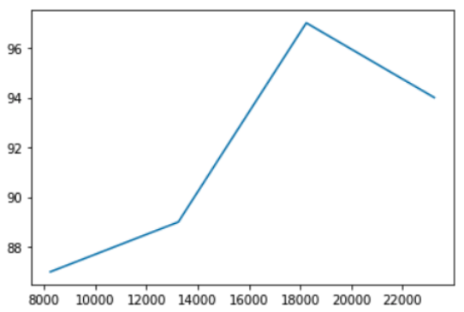
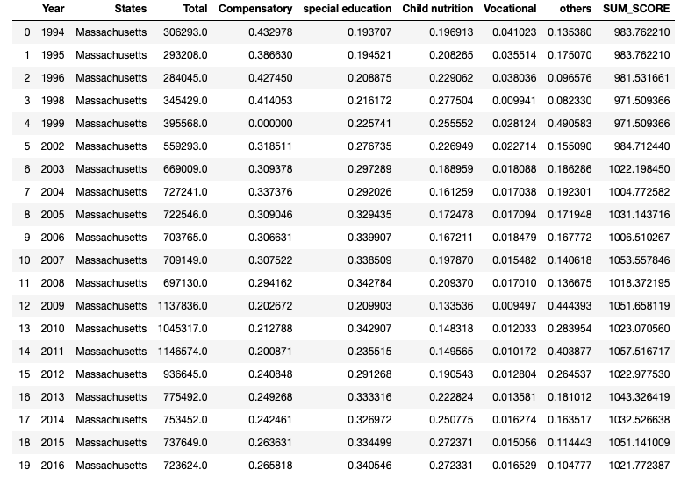
Overall Result
Graduated rate -- Expenditures per Pupil
MA data from all states dataset
All States(Grades -- Expenditures per Pupil)

